Slide 1










TRENDY PRESENTATION TRENDY PRESENTATION TRENDY PRESENTATION
DATA 400 PROJECT
By Margaret and Munkhtsatsral
PREDICTING COLLEGE DIVERSITY SCORES

Slide 2




Predicting College Diversity Scores
Our project aims to predict the diversity score of universities based on the composition of students and faculty, college ranking, and endowment.
The analysis covers both National Universities and Liberal Arts Colleges.
We examine data from the 2012-2013 to 2021-2022 academic years to determine factors influencing diversity.
Main goal: Predict the student and professor diversity score in 2021-2022 academic year.
TOPIC OR IDEA TOPIC OR IDEA
TOPIC OR IDEA TOPIC OR IDEA

Slide 3

Tractable Data and Data Retrieval
IPEDS: Integrated Postsecondary Education Data System
System of interrelated surveys conducted annually by the U.S Department of Education's National Center for Education Statistics
It gathers data from every college and university participating in federal student financial aid programs, with data collection occurring in the fall, winter, and spring.
U.S. News Ranking
U.S. News ranks nearly 1,500 U.S. four-year bachelor’s degree-granting institutions, organized within 10 distinct categories where colleges and universities are compared with others that share similar academic missions.
TOPIC OR IDEA TOPIC OR IDEA

Slide 4

Data Overview: National University
The dataset df_nu_final combines college characteristics and rankings from IPEDS data and US News data. It contains 126,445 rows and 50 columns.
The dataset df_nu_stu_diversity_training includes data from 2012-2013 to 2020-2021, with 110,928 rows and 50 columns. It is used to train the student diversity machine learning model.
The dataset df_nu_stu_diversity_test includes data from 2021-2022, with 14,028 rows and 50 columns. It is used to test the student diversity machine learning model.
The dataset df_nu_prof_diversity_training includes data from 2012-2013 to 2020-2021, with 109,829 rows and 50 columns. It is used to train the professor diversity machine learning model.
The dataset df_nu_prof_diversity_test includes data from 2021-2022, with 14,028 rows and 50 columns. It is used to test the professor diversity machine learning model.
TOPIC OR IDEA TOPIC OR IDEA
TOPIC OR IDEA TOPIC OR IDEA

Slide 5

Data Overview: Liberal Art College
The dataset df_lac_final combines college characteristics and rankings from IPEDS data and US News data. It contains 66,684 rows and 50 columns.
The dataset df_lac_stu_diversity_training includes data from 2012-2013 to 2020-2021, with 57,174 rows and 50 columns. It is used to train the student diversity machine learning model.
The dataset df_lac_stu_diversity_test includes data from 2021-2022, with 7,163 rows and 50 columns. It is used to test the student diversity machine learning model.
The dataset df_lac_prof_diversity_training includes data from 2012-2013 to 2020-2021, with 54,772 rows and 50 columns. It is used to train the professor diversity machine learning model.
The dataset df_lac_prof_diversity_test includes data from 2021-2022, with 7,163 rows and 50 columns. It is used to test the professor diversity machine learning model.
TOPIC OR IDEA TOPIC OR IDEA
TOPIC OR IDEA TOPIC OR IDEA

Slide 6





SUMMARY STATISTICS

Slide 7

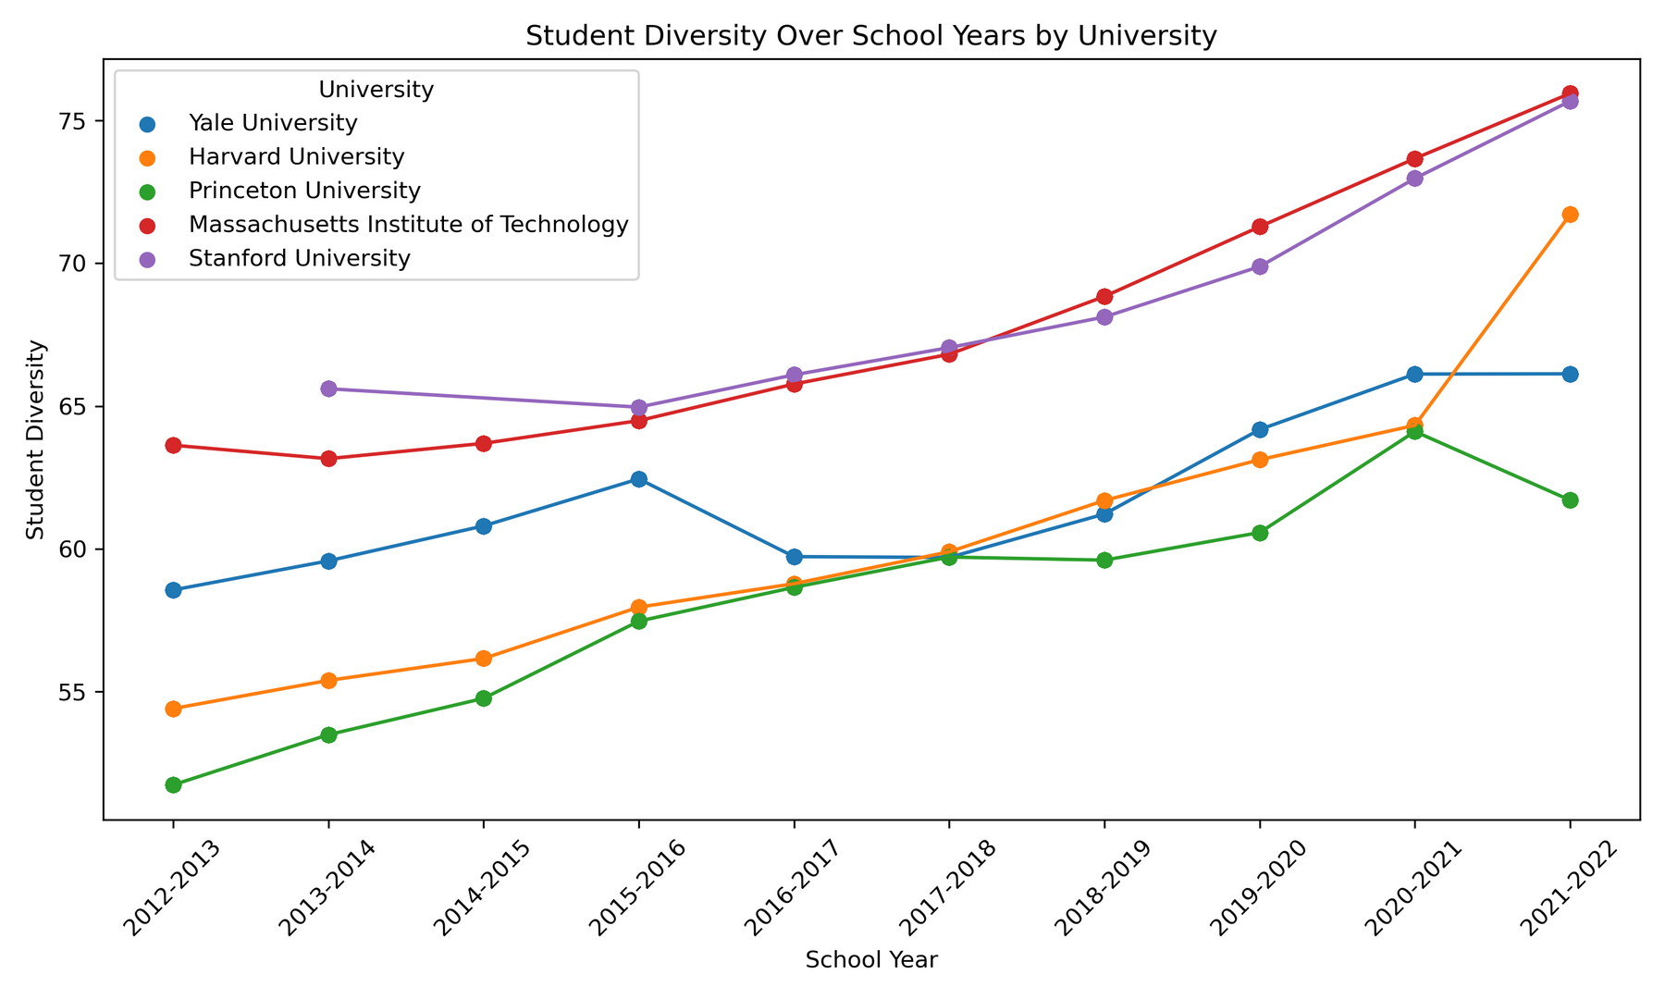
Student Diversity at Top Universities Based on the 2025 Best National University Rankings Over the Years

Slide 8
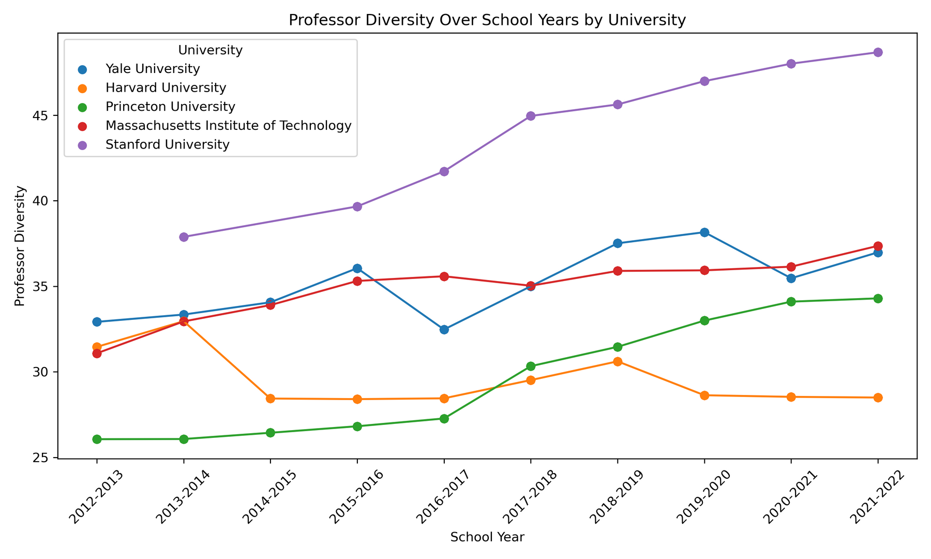
Professor Diversity at Top Universities Based on the 2025 Best National University Rankings Over the Years

Slide 9
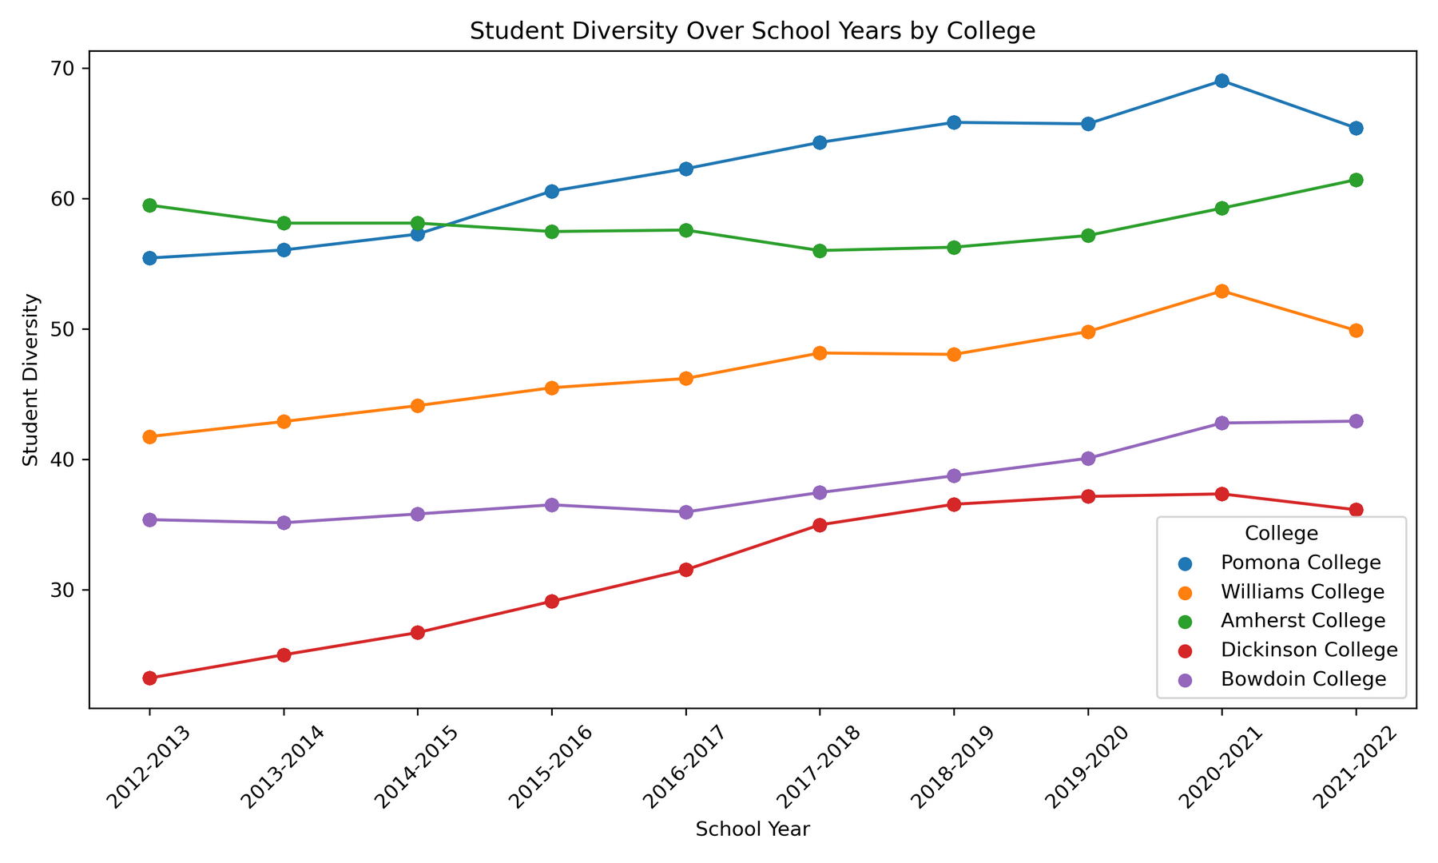
Student Diversity at Top Universities Based on the 2025 Liberal Arts College Rankings Over the Years

Slide 10
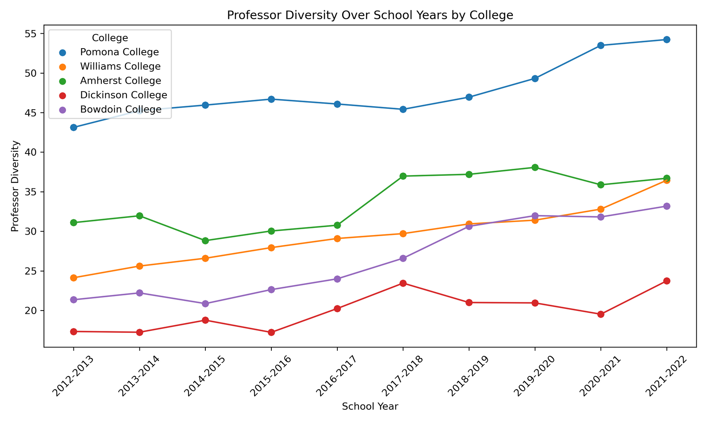
Professor Diversity at Top Universities Based on the 2025 Liberal Arts College Rankings Over the Years

Slide 11


TRENDY PRESENTATION TRENDY PRESENTATION TRENDY PRESENTATION
METHODOLOGY

Slide 12


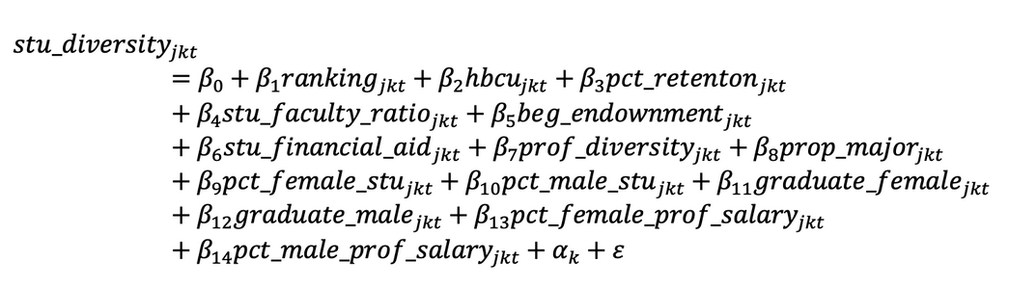
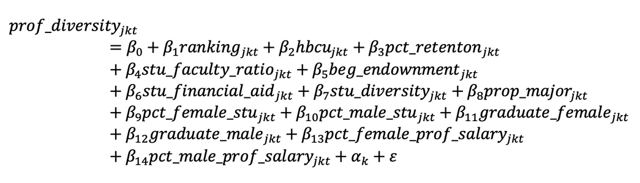
Machine Learning Models
j denotes each university, 𝑘 denotes each state, and 𝑡 denotes each school year.
The training set covers the years from 2012–2013 to 2020–2021.
The test set is the 2021–2022 school year.

Slide 13
RESULTS

Slide 14
TRENDY PRESENTATION TRENDY PRESENTATION TRENDY PRESENTATION
NATIONAL UNIVERSITY

Slide 15
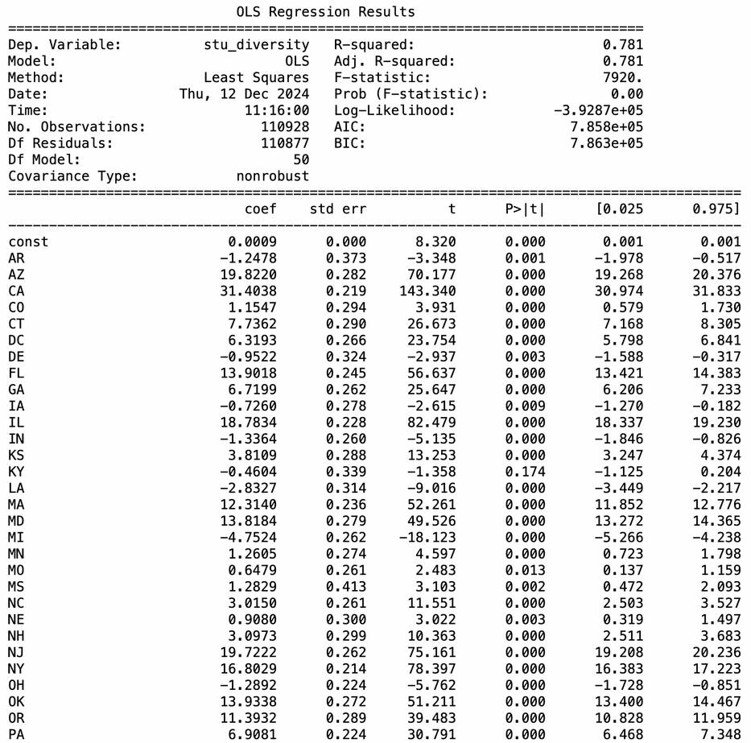
Student Diversity Model
The R-squared value for the student diversity model is 0.781, indicating that the model's independent variables explain 78.1% of the variation in student diversity.
The coefficient for New York is 16.8, indicating that, holding all other factors constant, being in New York is associated with an increase of 16.8 percentage points in student diversity.
The coefficient for Pennsylvania (PA) is 6.9081, suggesting that, all else being equal, being in Pennsylvania corresponds to an increase of 6.9081 percentage points in student diversity.
TOPIC OR IDEA TOPIC OR IDEA
TOPIC OR IDEA TOPIC OR IDEA

Slide 16
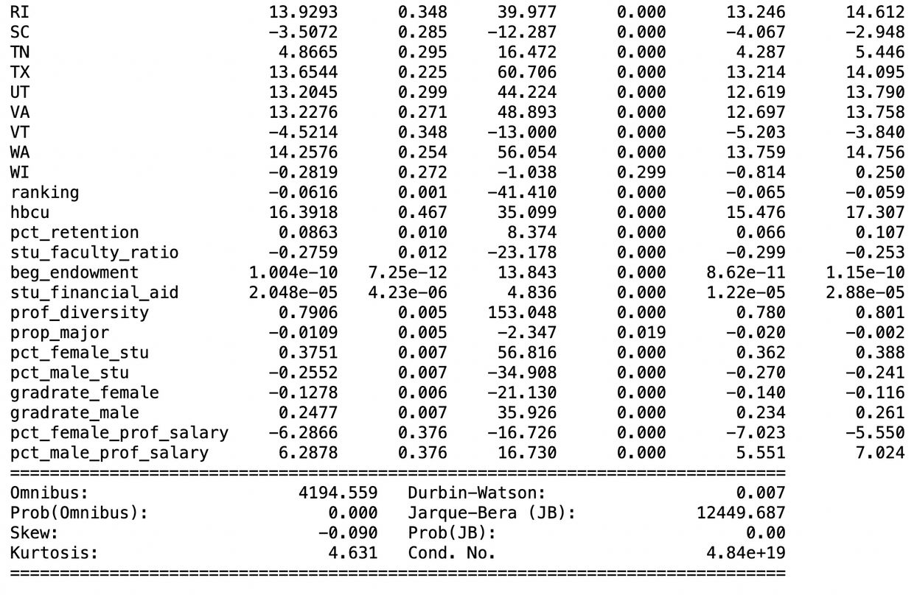
Student Diversity Model
The coefficient for percentage of female students is 0.3751, meaning that a 1 percentage point increase in the proportion of female students is associated with a 0.3751 percentage point increase in student diversity, holding other factors constant.
The coefficient for percentage of male students is -0.2552, indicating that a 1 percentage point increase in the proportion of male students is associated with a 0.2552 percentage point decrease in student diversity, controlling for other variables.
For Harvard: An MSE of 92.03 means that, on average, the squared difference between the predicted values and the actual values is 92.03.
TOPIC OR IDEA TOPIC OR IDEA
TOPIC OR IDEA TOPIC OR IDEA

Slide 17
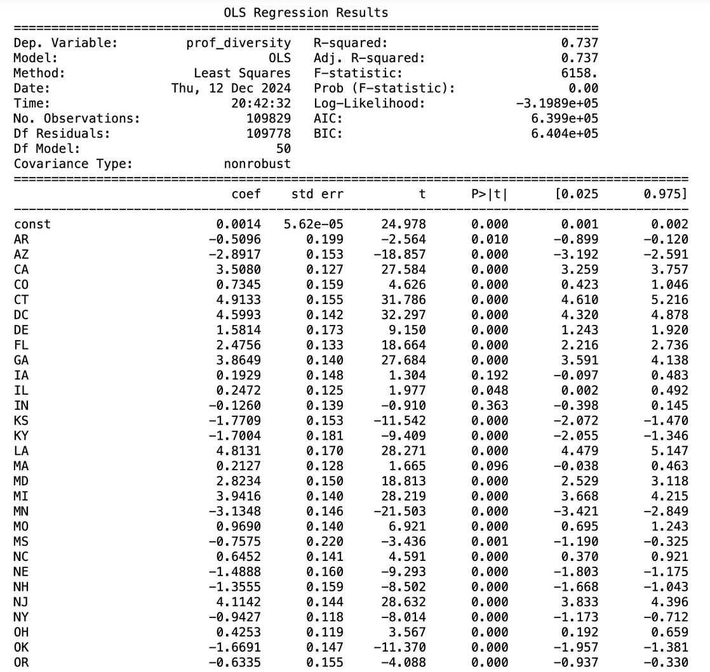
Professor Diversity Model
The R-squared value for the professor diversity model is 0.737, indicating that 73.7% of the variation in professor diversity is explained by the model's independent variables.
The coefficient for New York is -0.9427, suggesting that, holding all other factors constant, being in New York is associated with a 0.9427 percentage point decrease in professor diversity.
The coefficient for Pennsylvania (PA) is 1.3161, indicating that, holding all other factors constant, being in Pennsylvania corresponds to a 1.3161 percentage point increase in professor diversity.
TOPIC OR IDEA TOPIC OR IDEA
TOPIC OR IDEA TOPIC OR IDEA

Slide 18
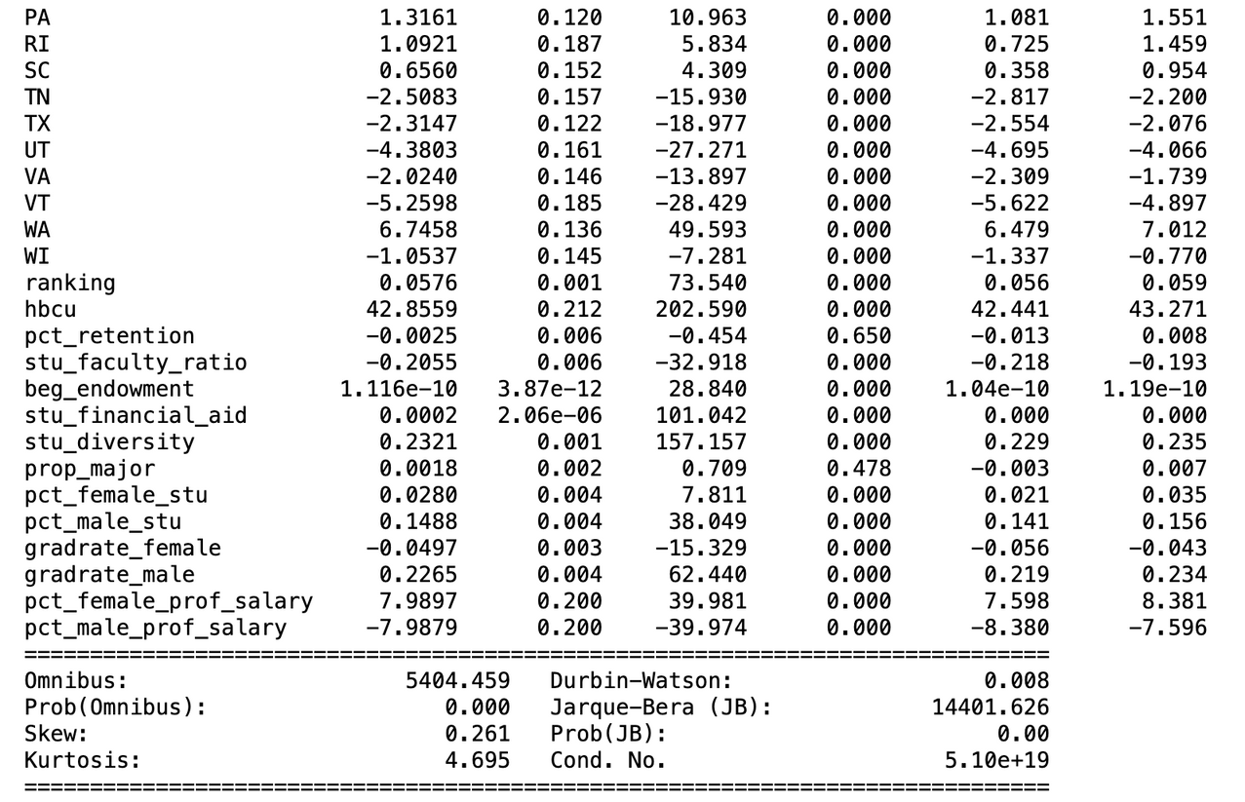
Professor Diversity Model
The coefficient for percentage of female professor salary is 7.9897, meaning a 1 percentage point increase in the proportion of female professor salaries is associated with a 7.9897 percentage point increase in professor diversity, holding other factors constant.
Conversely, the coefficient for percentage of male professor salary is -7.9879, indicating that a 1 percentage point increase in the proportion of male professor salaries is associated with a 7.9879 percentage point decrease in professor diversity, controlling for other variables.
For Harvard: An MSE of 93.09 means that, on average, the squared difference between the predicted values and the actual values is 93.09.
TOPIC OR IDEA TOPIC OR IDEA
TOPIC OR IDEA TOPIC OR IDEA

Slide 19
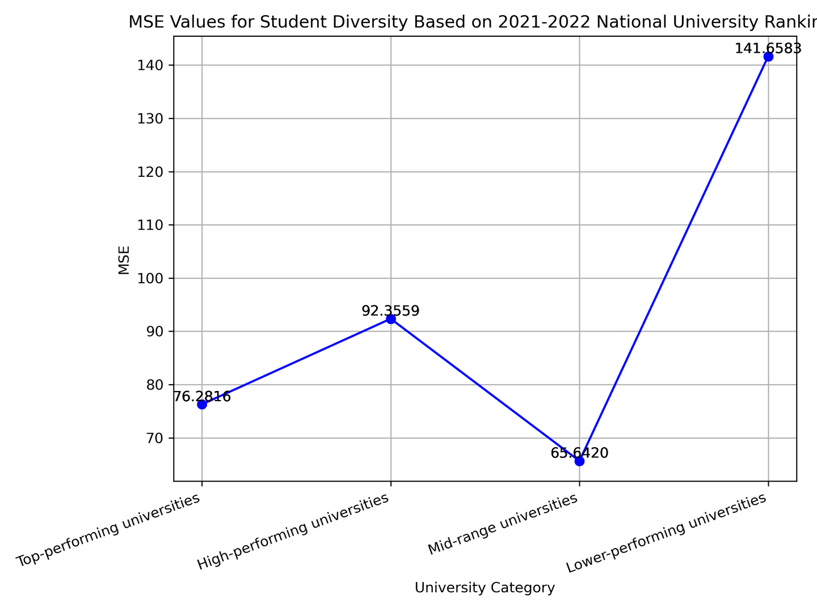
MSE Values for Student Diversity Based on 2021-2022 National University Rankings

Slide 20
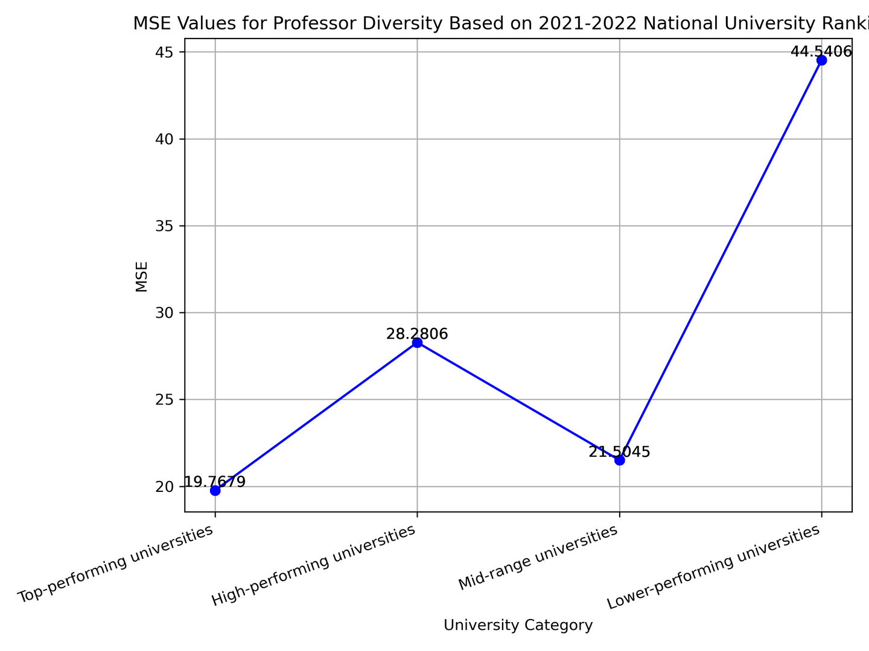
MSE Values for Professor Diversity Based on 2021-2022 National University Rankings

Slide 21
TRENDY PRESENTATION TRENDY PRESENTATION TRENDY PRESENTATION
LIBERAL ART COLLEGE

Slide 22
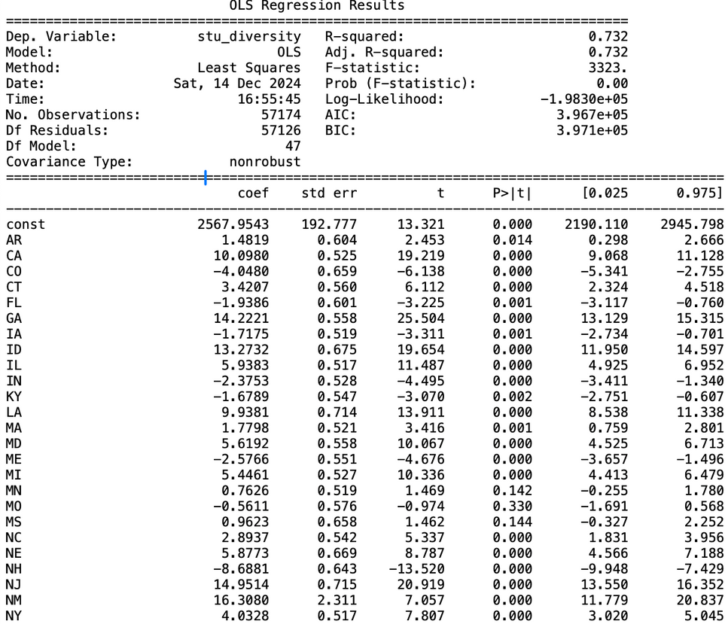
Student Diversity Model
The R-squared value for the model is 0.732, indicating that approximately 73.2% of the variation in student diversity is explained by the independent variables in the model.
The coefficient for California (CA) is 10.098, meaning that, holding all other factors constant, being in California is associated with an increase of 10.0980 percentage point in student diversity. This effect is statistically significant with a p-value of 0.00
The coefficient for Pennsylvania (PA) is 1.6212, indicating that, holding all other factors constant, being in Pennsylvania is associated with an increase of 1.6212 percentage point in student diversity. This effect is statistically significant, as the p-value is 0.001 (below the 0.05 threshold).
TOPIC OR IDEA TOPIC OR IDEA
TOPIC OR IDEA TOPIC OR IDEA

Slide 23
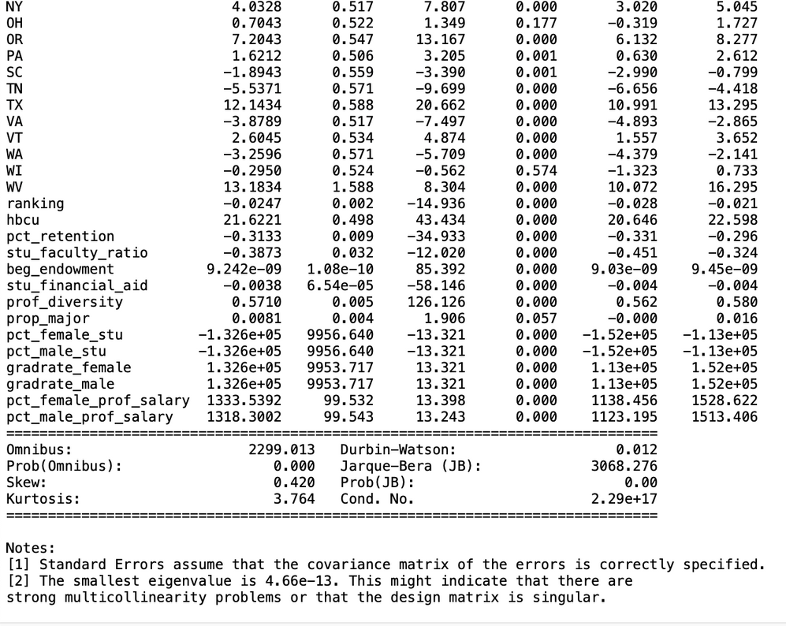
Student Diversity Model
Student-faculty ratio has a coefficient of -0.3873, suggesting a small but significant negative relationship with student diversity (p = 0.000).
Professorial diversity (prof_diversity) has a coefficient of 0.5710, indicating a strong positive relationship with student diversity, holding other variables constant
(p = 0.000).
For Dickinson College, the Mean Squared Error (MSE) of 0.616 indicates that the model's average squared prediction error for student diversity is moderate, reflecting some variability in accuracy. The Mean Absolute Error (MAE) of 0.783 suggests that, on average, predictions for student diversity at Dickinson College deviate by approximately 0.78 percentage point from the actual values.
TOPIC OR IDEA TOPIC OR IDEA
TOPIC OR IDEA TOPIC OR IDEA

Slide 24
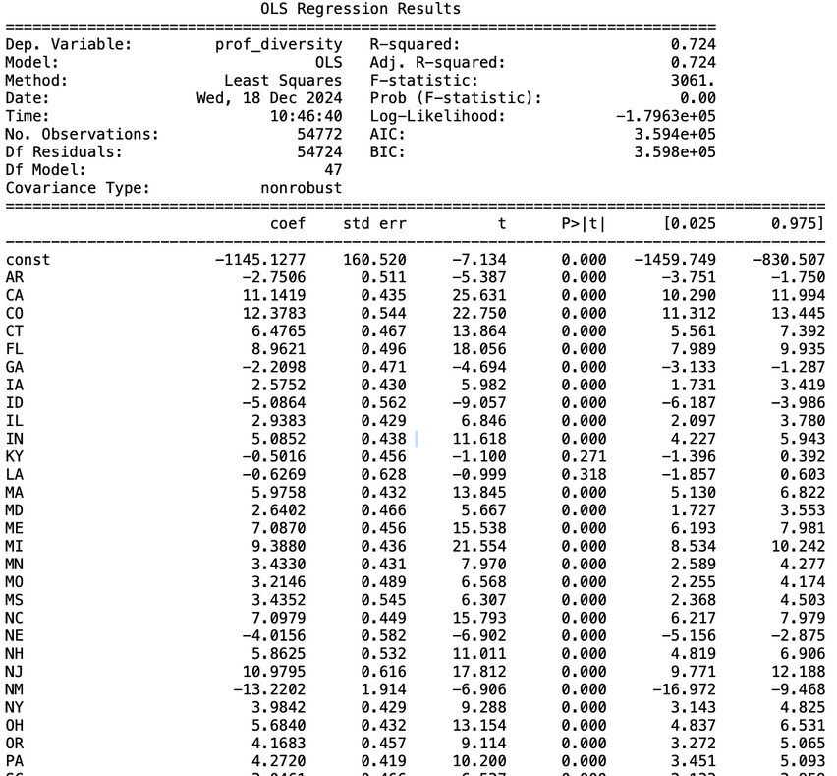
Professor Diversity Model
The R-squared value for the professor diversity model is 0.724, indicating that the independent variables in the model explain 72.4% of the variation in professor diversity.
California (CA) has a positive coefficient (11.1419), meaning universities in California tend to have higher professor diversity scores compared to the reference state.
The coefficient for Pennsylvania (PA) is 4.272, suggesting that, all else being equal, being in Pennsylvania corresponds to an increase of 4.27 percentage points in professor diversity.
TOPIC OR IDEA TOPIC OR IDEA
TOPIC OR IDEA TOPIC OR IDEA

Slide 25
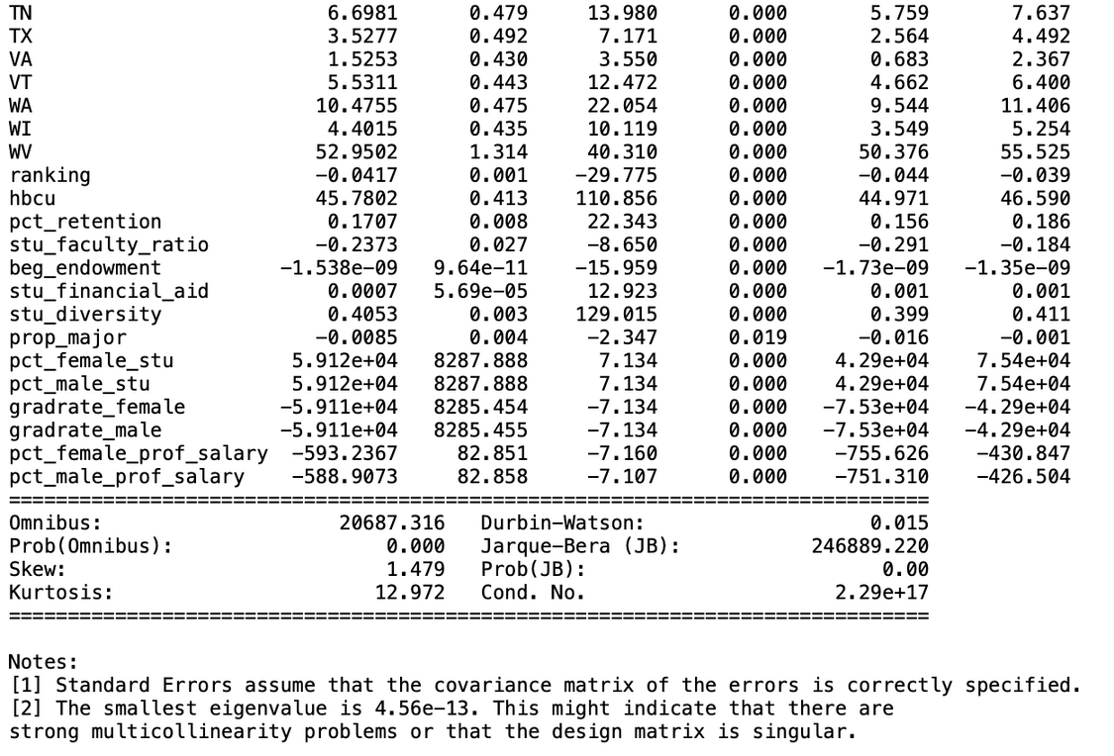
Professor Diversity Model
stu_diversity (0.4053): Strong positive association with professor diversity, as expected.
hbcu (45.7802): Being a Historically Black College or University is strongly associated with much higher professor diversity scores.
stu_financial_aid (0.0007): Financial aid correlates positively with professor diversity.
For Dickinson College, the Mean Squared Error (MSE) of 0.114 indicates that the model's average squared prediction error is low, highlighting good accuracy.
The Mean Absolute Error (MAE) of 0.332 suggests that, on average, predictions for professor diversity deviate by about 0.33 percentage point from the actual values
TOPIC OR IDEA TOPIC OR IDEA
TOPIC OR IDEA TOPIC OR IDEA

Slide 26
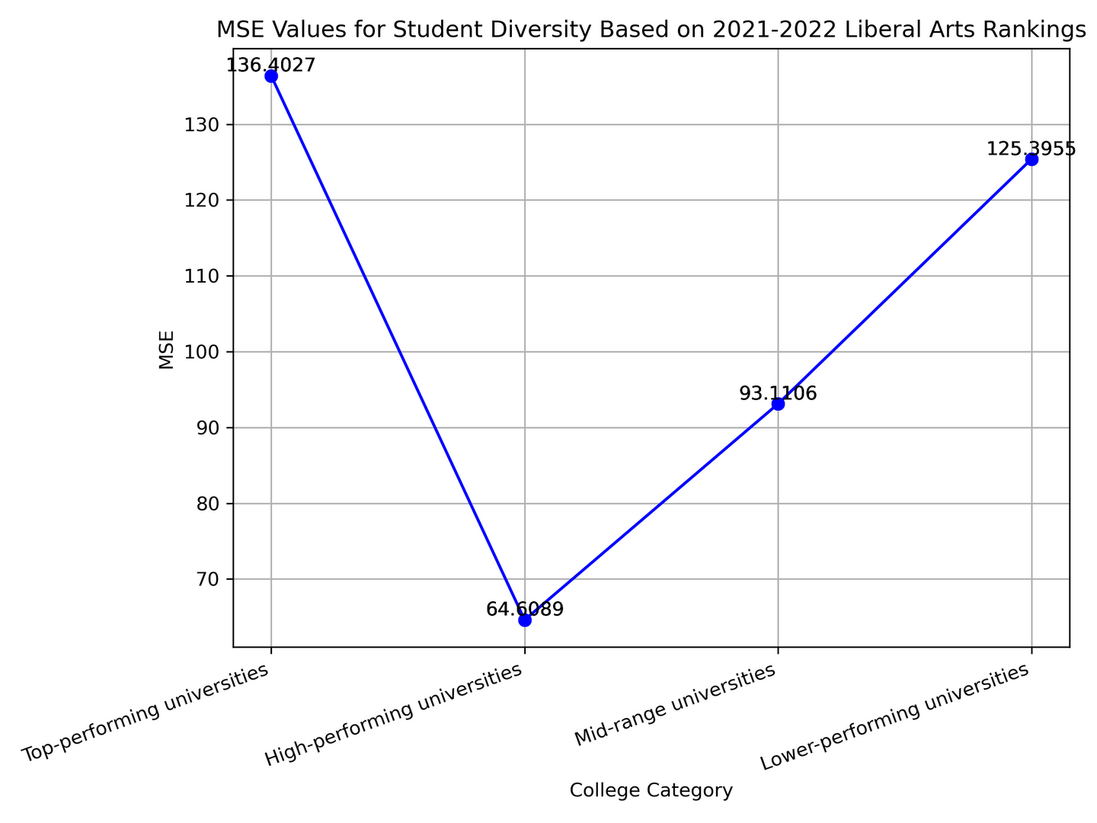
MSE Values for Student Diversity Based on 2021-2022 Liberal Art College Rankings

Slide 27
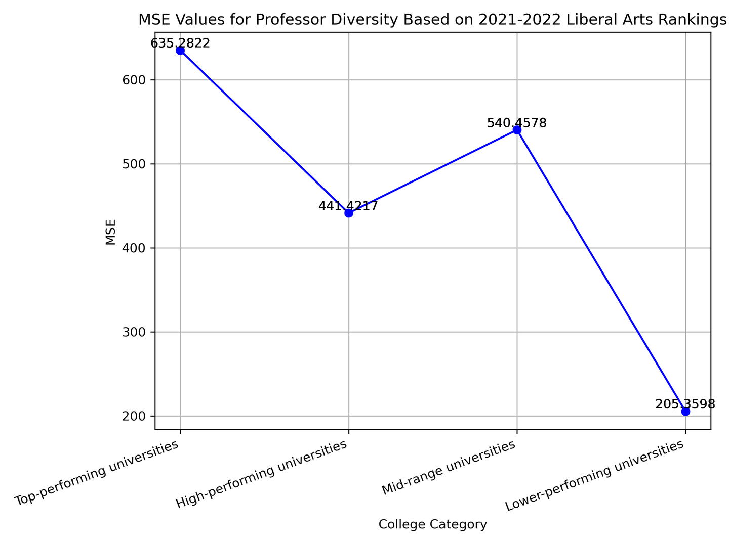
MSE Values for Professor Diversity Based on 2021-2022 Liberal Art College Rankings

Slide 28
TRENDY PRESENTATION TRENDY PRESENTATION TRENDY PRESENTATION
IMPLICATIONS FOR STAKEHOLDERS

Slide 29

Implications for Stakeholders
Universities:
Strategic Planning: Insight into diversity metrics helps institutions align their strategies to foster inclusive environments and meet diversity targets.
Resource Allocation: Identifying trends can guide the allocation of scholarships, support programs, and outreach efforts to underrepresented groups.
Reputation Management: Diversity scores may influence rankings and perceptions of inclusivity, impacting an institution’s reputation.
TOPIC OR IDEA TOPIC OR IDEA
TOPIC OR IDEA TOPIC OR IDEA

Slide 30

Implications for Stakeholders
Students:
Informed Choices: Prospective students can use diversity scores to choose institutions aligned with their values and preferences.
Enhanced Environment: Greater diversity fosters inclusive campuses that improve learning and social experiences.
Policy Makers:
Policy Development: Helps evaluate the effectiveness of state or federal diversity initiatives and policies.
Employers:
Talent Pipeline: Diverse campuses indicate universities producing graduates with varied perspectives and experiences, which employers value.
TOPIC OR IDEA TOPIC OR IDEA
TOPIC OR IDEA TOPIC OR IDEA

Slide 31
ETHICAL, LEGAL, AND SOCIETAL CONSIDERATIONS

Slide 32



Ethical, Legal, and Societal Considerations
Ethical Considerations
Algorithmic Bias: The model must ensure fairness, avoiding biases in predictions due to historical data reflecting systemic inequalities.
Equity vs. Equality: Predictions should aim to promote equity rather than reinforce inequalities.
Societal Considerations:
Promotes broader access to education for underrepresented groups, addressing systemic barriers.
Highlights disparities that require targeted interventions at institutional and societal levels.
TOPIC OR IDEA TOPIC OR IDEA

Slide 33

Ethical, Legal, and Societal Considerations
Legal Considerations:
Comply with laws such as Title VI of the Civil Rights Act, which prohibits discrimination based on race, color, or national origin in programs receiving federal funding.
Be cautious of how diversity metrics are used in admissions decisions, especially in jurisdictions where affirmative action policies are contested.
TOPIC OR IDEA TOPIC OR IDEA

Slide 34
THANK YOU!
Any questions?

